Slide 1
What is AI?
A brief Introduction

Slide 2
Artificial Intelligence
Software to simulate human intelligence in machines so that they can perform human tasks.
Language Translation from English to French
Chest Disease Detection

Slide 3
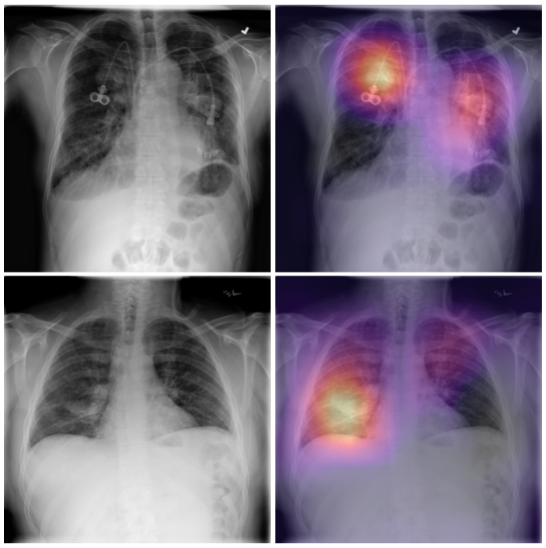
ChexNet
Chest Disease Detection
Comparable performance to practicing radiologist
Detects 14 clinically important diseases in chest radio graphs
Source: Stanford
Notes:
Medical use
Detect up to 14 diseases through chest radiographs
Accuracy is equivalent to radiologists

Slide 4
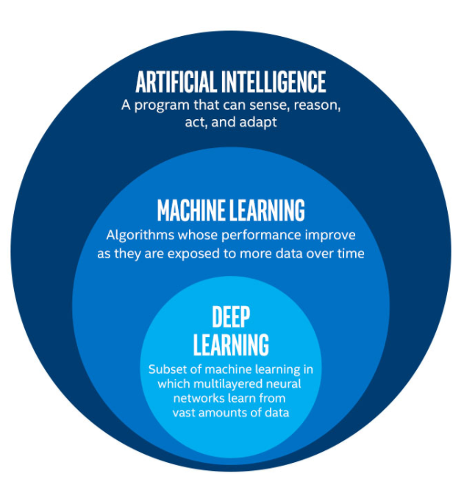
Subests of AI
Notes:
AI – broad term, big umbrella -> break it down
Ai > ML > Deep Learning

Slide 5
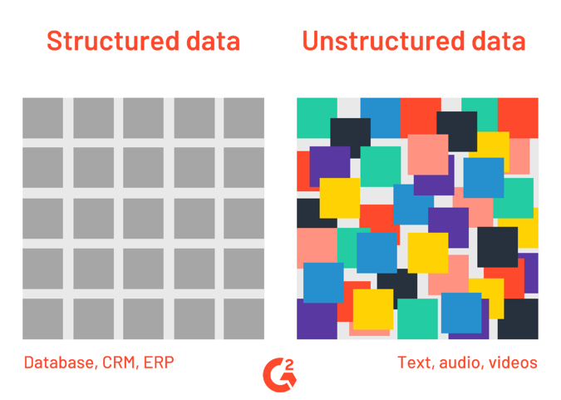
Subests of AI
ML- Set of algorithms to recognize patterns within structured data (e.g. tabular data)
DL- Mimic human brains to recognize patterns within huge unstructured datasets (e.g. images, text, music, audio)
Notes:
* Unstructured data -> Structured data

Slide 6
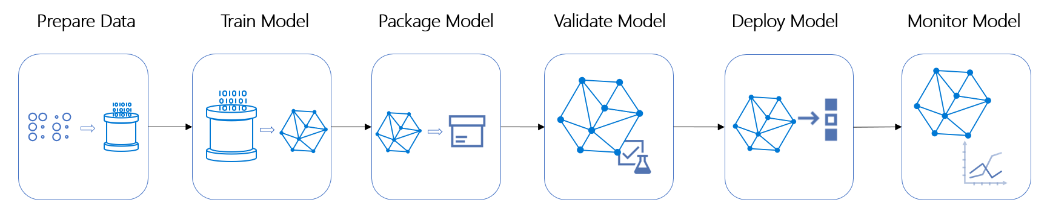
Machine learning Pipeline
Notes:
Every ML project -> steps of a ML project
Prepare data: important step
Train model: build algos
Validate mode: if acc. High -> deploy model/make it live. I
If acc. Bad, go back to train_model step to try other algos and re-trai

Slide 7
Today
Linear Regression - predict house prices
Logistic Regression - distinguish Irow flower types
Fundamental terms:
Underfitting & Overfitting
Feature Engineering

